Slide 1

Project Report On Micro Credit Defaulter
Presented By: Swati Kumari

Slide 2
Agenda:
Overview.
Problem Statement.
Problem Understanding.
What is Micro Credit?
Importance of Micro Credit Defaulter Model.
Exploratory data analysis.
Visualizations.
Analysis.
Data cleaning steps.
Data Balancing.
Model Building.
ROC-AUC Curve.
Hyper Parameter Tunning.
ROC Curve For Final Model.
Saving the model and predictions from saved best model.
Conclusion.

Slide 3
Overview:
In this particular presentation we will be looking on:
How to analyze the dataset of Micro Credit Defaulters.
What are the EDA steps in cleaning the dataset.
Overall analysis on the problem.
Model building from the cleaned dataset.
Predicting defaulters for saved model.

Slide 4
Problem Statement:
A Microfinance Institution (MFI) is an organization that offers financial services to low income populations. MFS becomes very useful when targeting especially the unbanked poor families living in remote areas with not much sources of income. The Microfinance services (MFS) provided by MFI are Group Loans, Agricultural Loans, Individual Business Loans and so on.
Many microfinance institutions (MFI), experts, and donors are supporting the idea of using mobile financial services (MFS) which they feel are more convenient and efficient and cost-saving, than the traditional high-touch model used for long for the purpose of delivering microfinance services. Though the MFI industry is primarily focusing on low-income families and is very useful in such areas, the implementation of MFS has been uneven with both significant challenges and successes. Today, microfinance is widely accepted as a poverty-reduction tool, representing $70 billion in outstanding loans and a global outreach of 200 million clients.
We are working with one such client that is in Telecom Industry. They are a fixed wireless telecommunications network provider. They have launched various products and have developed its business and organization based on the budget operator model, offering better products at Lower Prices to all value-conscious customers through a strategy of disruptive innovation that focuses on the subscriber.

Slide 5
Problem Understanding:
Telecom Industries understand the importance of communication and how it affects a person’s life, thus, focusing on providing their services and products to low income families and poor customers that can help them in the need of hour. They are collaborating with an MFI to provide micro-credit on mobile balances to be paid back in 5 days. The Consumer is believed to be defaulter if he deviates from the path of paying back the loaned amount within the time duration of 5 days. For the loan amount of 5 (in Indonesian Rupiah), payback amount should be 6 (in Indonesian Rupiah), while, for the loan amount of 10 (in Indonesian Rupiah), the payback amount should be 12 (in Indonesian Rupiah).
The sample data is provided to us from our client database. It is hereby given to you for this exercise. In order to improve the selection of customers for the credit, the client wants some predictions that could help them in further investment and improvement in selection of customers. We have to build a model which can be used to predict in terms of a probability for each loan transaction, whether the customer will be paying back the loaned amount within 5 days of insurance of loan. In this case, Label ‘1’ indicates that the loan has been payed i.e. Non- defaulter, while, Label ‘0’ indicates that the loan has not been payed i.e. defaulter.

Slide 6

What is Micro Credit?
Microcredit is an extremely small loan given to those who lack a steady source of income, or collateral. It is used as a way to obtain a loan, acting as a protection against potential loss for the lender should the borrower default in his payments., or any credit history.
It provides very small loans, or micro-loans, to poor people, mostly women, to start or expand very small, self-sufficient businesses. Through their own ingenuity and drive, and with the support of the lending microfinance institution (MFI), poor people are able start their journey out of poverty.
, Unlike commercial loans, no collateral is required for a micro-loan and it is usually repaid within six months to a year. Those funds are then recycled as other loans, keeping money working and in the hands of borrowers.

Slide 7

Importance of Micro Credit Defaulters Model.
Poverty alleviation programs provide material, funds, information and project services for people with no income or work opportunities. Because of the credit risks and relatively high costs associated with small loans, the traditional banking system is generally not willing to implement a microcredit system. The borrowers have no collateral to put up against loans and often are refused the needed capital because of the high risk of default. If they resort to underground sources, they are often charged exorbitant interest. This quick fix solution does not address the main structural problem: a lack of proper funding channels.

Slide 8
Exploratory Data Analysis:
As a first step I have imported the required libraries and I have imported the dataset which was in CSV format.
Then I did all the statistical analysis like checking shape, nunique, value counts, info, etc…..
While checking the value counts of the datasets I found some columns with more than 90% zero values, so these columns will create skewness in the datasets so I decided to drop those columns.
While Checking the null values I found there is no null values in the dataset.
I have dropped the ‘pcircle’,’msisdn’, and 'pdate’ columns.

Slide 9
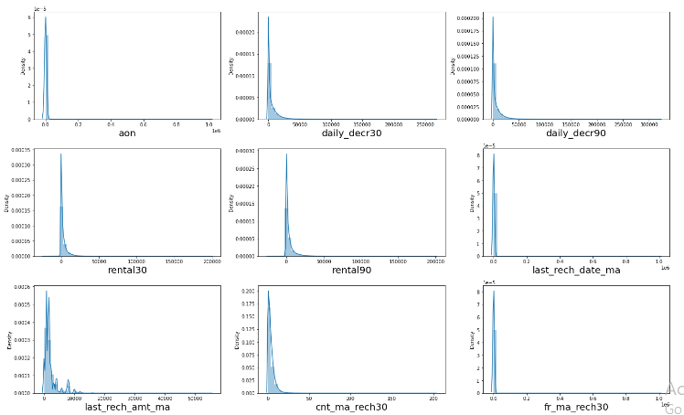
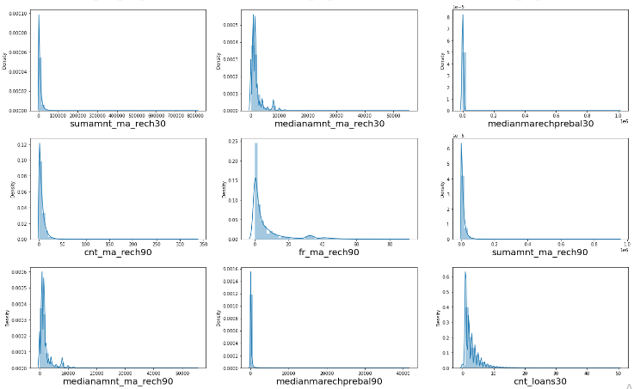
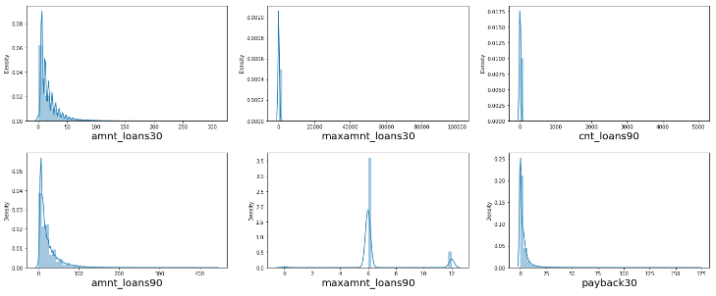
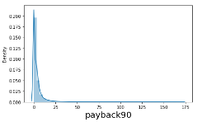
Visualization[Univariate]:

Slide 10
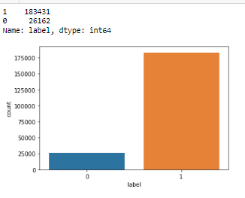
Vizualization[Univariate-Target]:
There is a data imbalancing issue so we have to treat this by using oversampling or undersampling.

Slide 11
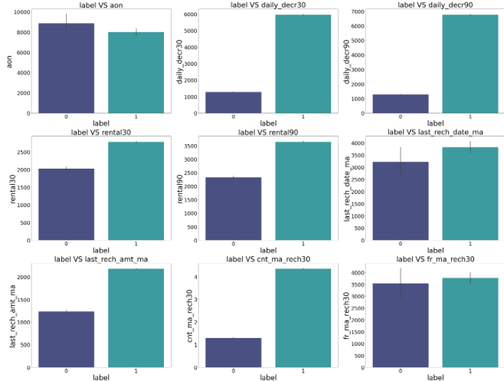
Vizualization[Bivariate]:

Slide 12
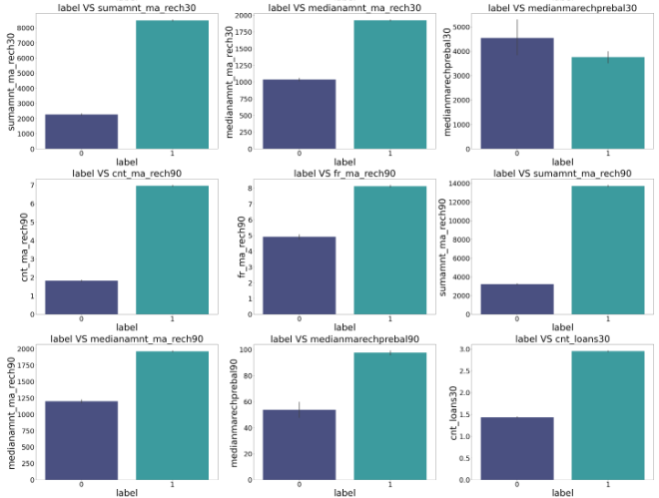
Visualization of numerical columns:

Slide 13
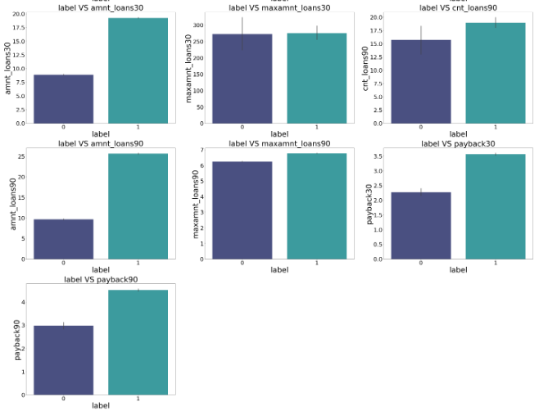
Vizualization

Slide 14
Observations:
1.Customers with high value of Age on cellular network in days(aon) are maximum defaulters(who have not paid there loan amount-0).
2.Customers with high value of Daily amount spent from main account, averaged over last 30 days (in Indonesian Rupiah)(daily_decr30) are maximum Non-defaulters(who have paid there loan amount-1).
3.Customers with high value of Daily amount spent from main account, averaged over last 90 days (in Indonesian Rupiah)(daily_decr90) are maximum Non-defaulters(who have paid there loan amount-1).
4.Customers with high value of Average main account balance over last 30 days(rental30) are maximum Non-defaulters(who have paid there loan amount-1).
5.Customers with high value of Average main account balance over last 90 days(rental90) are maximum Non-defaulters(who have paid there loan amount-1).
6.Customers with high Number of days till last recharge of main account(last_rech_date_ma) are maximum Non-defaulters(who have paid there loan amount-1).
7.Customers with high value of Amount of last recharge of main account (in Indonesian Rupiah)(last_rech_amt_ma) are maximum Non-defaulters(who have paid there loan amount-1).
8.Customers with high value of Number of times main account got recharged in last 30 days(cnt_ma_rech30) are maximum Non-defaulters(who have paid there loan amount-1).
9.Customers with high value of Frequency of main account recharged in last 30 days(fr_ma_rech30) are maximum Non-defaulters(who have paid there loan amount-1) and also the count is high for defaulters comparitively Non-defaulters are more in number.

Slide 15
Observations:
10.Customers with high value of Total amount of recharge in main account over last 30 days (in Indonesian Rupiah)(sumamnt_ma_rech30) are maximum Non-defaulters(who have paid there loan amount-1).
11.Customers with high value of Median of amount of recharges done in main account over last 30 days at user level (in Indonesian Rupiah)(medianamnt_ma_rech30) are maximum Non-defaulters(who have paid there loan amount-1).
12.Customers with high value of Median of main account balance just before recharge in last 30 days at user level (in Indonesian Rupiah)(medianmarechprebal30) are maximum defaulters(who have not paid there loan amount-0).
13.Customers with high value of Number of times main account got recharged in last 90 days(cnt_ma_rech90) are maximum Non-defaulters(who have paid there loan amount-1).
14.Customers with high value of Frequency of main account recharged in last 90 days(fr_ma_rech90) are maximum Non-defaulters(who have paid there loan amount-1).
15.Customers with high value of Total amount of recharge in main account over last 90 days (in Indonasian Rupiah)(sumamnt_ma_rech90) are maximum Non-defaulters(who have paid there loan amount-1).
16.Customers with high value of Median of amount of recharges done in main account over last 90 days at user level (in Indonasian Rupiah)(medianamnt_ma_rech90) are maximum Non-defaulters(who have paid there loan amount-1).
17.Customers with high value of Median of main account balance just before recharge in last 90 days at user level (in Indonasian Rupiah)(medianmarechprebal90) are maximum Non-defaulters(who have paid there loan amount-1).
18.Customers with high value of Number of loans taken by user in last 30 days(cnt_loans30) are maximum Non-defaulters(who have paid there loan amount-1).

Slide 16
Observations:
19. Customers with a high value of Total amount of loans taken by the user in the last 30 days(amnt_loans30) are maximum Non-defaulters(who have paid there loan amount-1).
20.Customers with high value of maximum amount of loan taken by the user in last 30 days(maxamnt_loans30) are maximum Non-defaulters(who have paid there loan amount-1).
21.Customers with high value of Number of loans taken by user in last 90 days(cnt_loans90) are maximum Non-defaulters(who have paid there loan amount-1).
22.Customers with high value of Total amount of loans taken by user in last 90 days(amnt_loans90) are maximum Non-defaulters(who have paid there loan amount-1).
23.Customers with high value of maximum amount of loan taken by the user in last 90 days(maxamnt_loans90) are maximum Non-defaulters(who have paid there loan amount-1).
24.Customers with high value of Average payback time in days over last 30 days(payback30) are maximum Non-defaulters(who have paid there loan amount-1).
25.Customers with high value of Average payback time in days over last 90 days(payback90) are maximum Non-defaulters(who have paid there loan amount-1).
26.In between 6th and 7th month maximum customers both defualters and Non-defaulters have paid there loan amount.
27.Below 14th of each month all the customers have paid there loan amount.

Slide 17
Analysis:
I have used dist plot for each univariate numerical features and it says that there is skewness in almost all columns.
And also for bivariate numerical features I have used bar plot.
I found that in maximum features the count of non-defaulters is high compared to defaulters so the risk is less comparitively.

Slide 18
Data Cleaning Steps:
In my datasets I did not found null values, but I found outliers and also skewness.
To remove outliers I have used percentile method. And to remove skewness I have used yeo-johnson method.
Use of Pearson’s correlation coefficient to check the correlation between dependent and independent features.
Also I have used Normalization. Then followed by model building with all Classification algorithms.

Slide 19
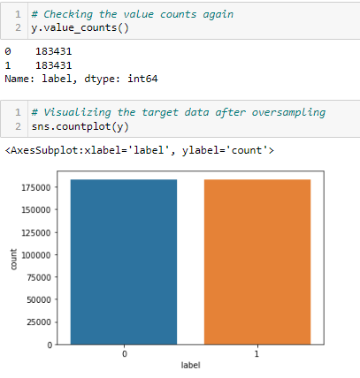
Data Balancing:
I have used oversampling (SMOTE) to get rid of data imbalancing. The balanced output looks like this.

Slide 20
Model Building:
Since Label was my target and it was a Categorical column, so this perticular problem was Classification problem. And I have used all Classification algorithms to build my model. By looking into the difference of accuracy score and cross validation score I found BaggingClassifier as a best model with least difference. Also to get the best model we have to run through multiple models and to avoid the confusion of overfitting we have go through cross validation. Below are the list of Classification algorithms I have used in my project.
Logistic Regresson
DecisionTreeClassifier
K-Neighbour Classifier
GuassianNB
Random Forest classifier
AdaBoostClassifier

Slide 21
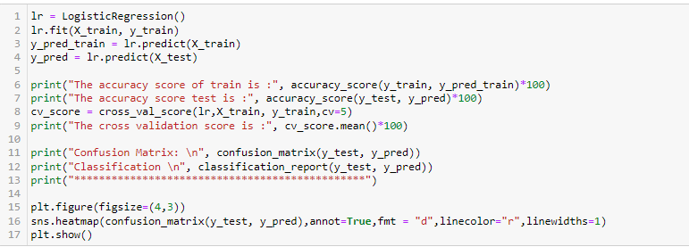
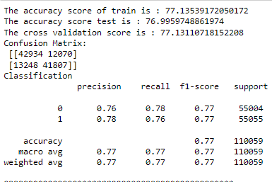
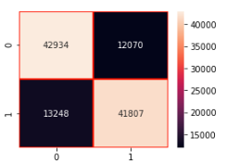
i) Logistic regresson:
The logistic regression model gave us train score of 77.1% and a test score of 76.9% of accuracy and a cross validation score of 77.1 % for the test model which is very near and also the precision, accuracy score are also high.

Slide 22
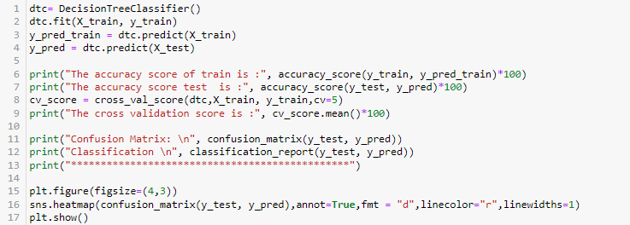
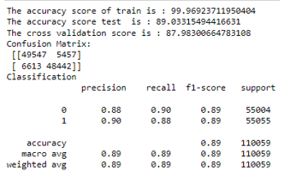
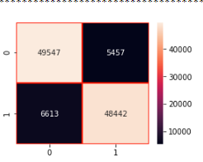
ii) DecisionTreeClassifier:
DecisionTreeClassifier model gave us train score of 99.9% and test score of 89% of accuracy and cross validation score of 87.9 % for the test model. Here the model is overfitting as there is large difference between train score and test score.

Slide 23
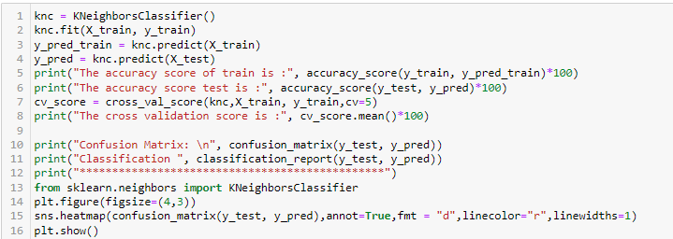
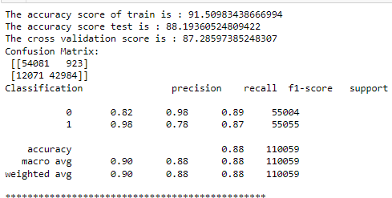
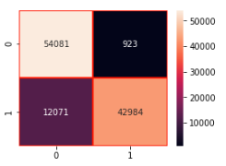
iii) K-Neighbour Regressor:
KNN classifier has given us 91.5% and 88% of accuracy and cv score of 87.5% for the test dataset.

Slide 24
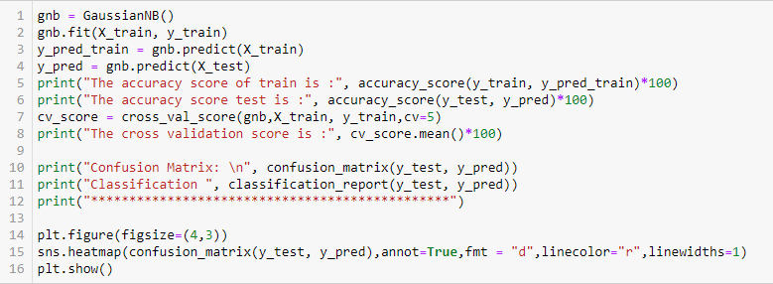
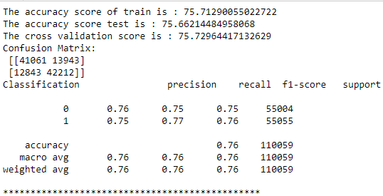
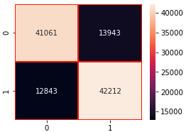
iv) GaussianNB:
GaussianNB() model gave us train score of 75.7% and test score of 75.6% of accuracy and cross validation score of 75.7 % for the test model. Here the model accuracy is low as compared to other models..

Slide 25
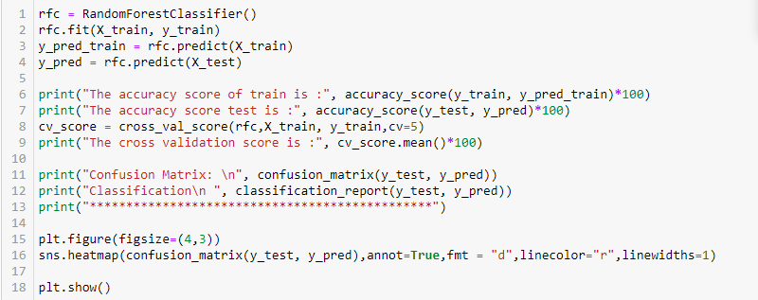
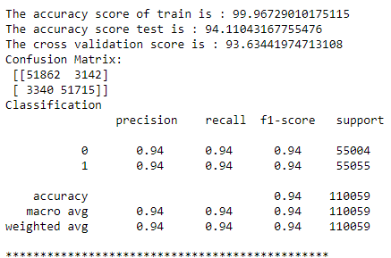
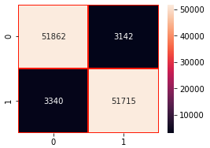
v)Random Forest Classifier:
Random Forest classifier model gave us train score of 99.9% and test score of 94.1% of accuracy and cross validation score of 93.6% and also metric values are near to 1 which is very good score.

Slide 26
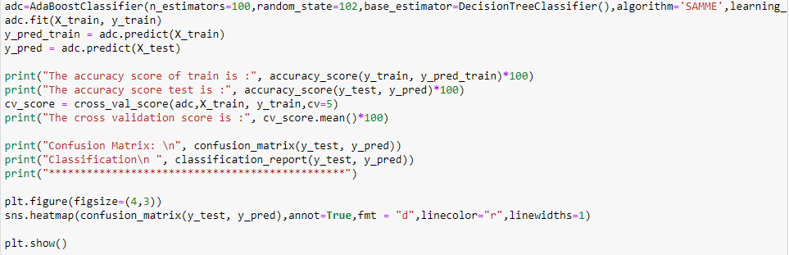
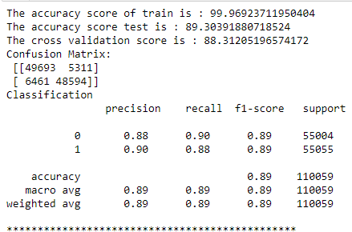
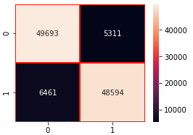
vi) AdaBoost Classifier
AdaBoostClassifier model gave us train score of 99.9% and test score of 89.3% of accuracy and cross validation score of 93.6% .Here the model is overfitting as there is large difference between train score and test score.

Slide 27
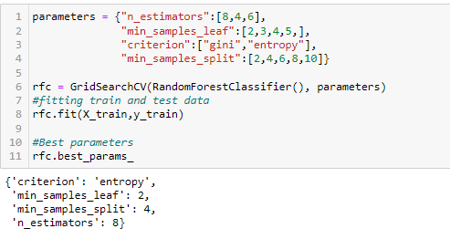
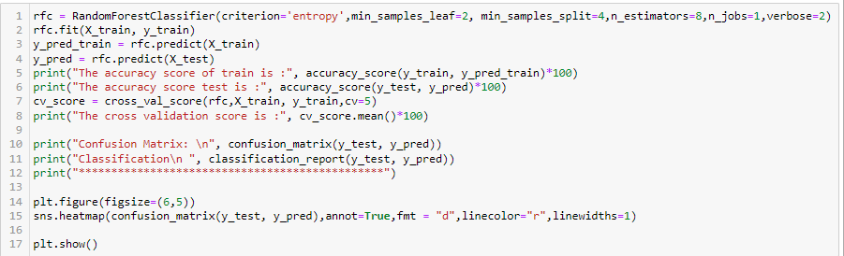

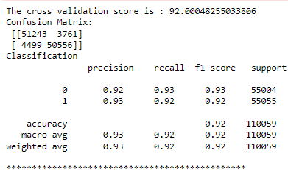
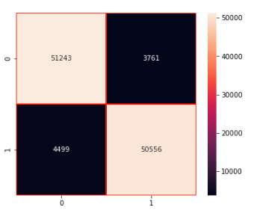
Hyper Parameter Tunning:
We are selecting random forest classifier model to increase the accuracy using Gridsearch CV method as it is giving the highest accuracy with least train and test score difference
We see that even after hyperparameter optimization, there is no much changes in the accuracy score, Hence saving the previous model for reference.

Slide 28
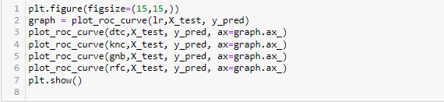
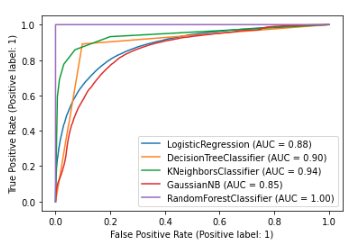
AUC ROC CURVE
Here we can see that we are getting Random forest classifier accuracy score as best score also AUC ROC curve is having value 1

Slide 29

Saving the Best Model
We see that Random forest classifier model has given the highest AUC in graph, the accuracy score of 97% and CV score of 96% which is highest among all the models tested. also we see that evaluation metrics are high for this model. Hence we will be saving this model.

Slide 30
Conclusion:
The dataset was very challenging to handle it had 37 features with 30days and 90days information of customers.
Firstly, the datasets were not having any null values.
But there was huge number of zero entries in maximum columns so we have to be careful while going through the statistical analysis of the datasets.
And proper ploting for proper type of features will help us to get better insight on the data. I found maximum numerical columns in the dataset so I have choosen bar plot to see the relation between target and features.
I notice a huge amount of outliers and skewness in the data so we have chosen proper methods to deal with the outliers and skewness. If we ignore these outliers and skewness we may end up with a bad model which has less accuracy. So I used the percentile method to remove outliers.
Then scaling dataset has a good impact like it will help the model not to get baised. Since we have not removed outliers and skewness completely from the dataset so we have to choose Normalization.
We have to use multiple models while building model using dataset as to get the best model out of it.
And we have to use multiple metrics like F1_score, precision, recall and accuracy_score which will help us to decide the best model.
I found Random Forest Classifier as the best model with 94.1% accuracy_score. Also I have improved the accuracy of the best model by running hyperparameter tunning.
At last I have predicted whether the loan is paid back or not using a saved model. It was good!! that I was able to get the predictions near to actual values.

Slide 31


